Slide 2
FLORIDA ORGANICS RECYCLING PROGRAM UPDATE
Lauren O’Connor
Permitting and Compliance Assistance Program
Division of Waste Management
Florida Department of Environmental Protection
Orlando, Florida | June 25, 2024

Slide 3
CURRENT STATE OF ORGANICS IN FLORIDA
2022 FLORIDA MUNICIPAL SOLID WASTE (MSW)
MSW COLLECTED - 50.7 MILLION TONS
MSW COLLECTED AND RECYCLED - ORGANICS
MUNICIPAL SOLID WASTE COLLECTED ¹ |  |  | MUNICIPAL SOLID WASTE RECYCLED
ORGANIC MATERIALS | TONS PER YEAR | % OF TOTAL TONS PER YEAR | TOTAL TONS RECYCLED | % OF TOTAL TONS RECYCLED | MATERIAL RECYCLING RATE² (PERCENT)
Newspapers | 548,096 | 1.1 | 68,123 | 0.3 | 12%
Corrugated Cardboard | 3,284,760 | 6.5 | 1,292,183 | 6.3 | 39%
Office Paper | 772,232 | 1.5 | 125,677 | 0.6 | 16%
Other Paper | 3,812,386 | 7.5 | 304,762 | 1.5 | 8%
Yard Waste | 5,132,790 | 10.1 | 3,043,215 | 14.7 | 59%
Food Wastes | 3,391,072 | 6.7 | 211,106 | 1.0 | 6%
Process Fuel ³ | N/A⁴ | N/A | 111,460 | 0.5 | 100%
¹Municipal solid waste collected is the total recycled, landfilled and combusted. ²Unadjusted traditional recycling rate. ³Process fuel is composed of yard, wood and paper waste used in process boilers.

Slide 4
CURRENT STATE OF ORGANICS IN FLORIDA
The focus of Florida organics recycling has been on the production and use of compost processed at Source-Separated Organic Processing Facilities (SOPFs). SOPFs include yard trash, manure, animal byproducts and vegetative wastes.
In 2023, Florida had approximately 400 SOPFs and permitted organics recycling facilities processing over three million tons of organics that were diverted for beneficial use.
In 2023, there was an increase in community compost operations processing food waste throughout the state.
Florida Department of Environmental Protection (DEP) is currently in rulemaking to update Chapter 62-709, Florida Administrative Code (F.A.C.) – Criteria for Organics Processing and Recycling Facilities for updates.

Slide 5
FLORIDA COMPOSTING FACILITIES
REGISTERED/PERMITTED
Registered Source-Separated Organics Processing Facilities Recycling/Composting Organics Yard trash mulching/composting. Manure composting/blending. Pre- and post-consumer vegetative (food) waste composting. Animal byproducts (meats, eggs and dairy) composting. Sargassum seaweed. | 320 7 20 5 1
Permitted Solid Waste Composting Facilities | 5
Permitted Biosolids Composting Facilities | 15
Permitted Anaerobic Composting Facilities | 5

Slide 6
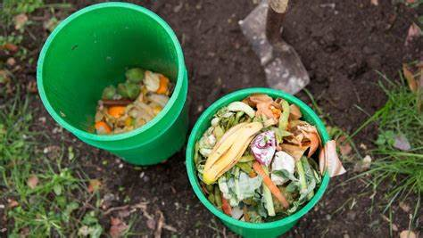
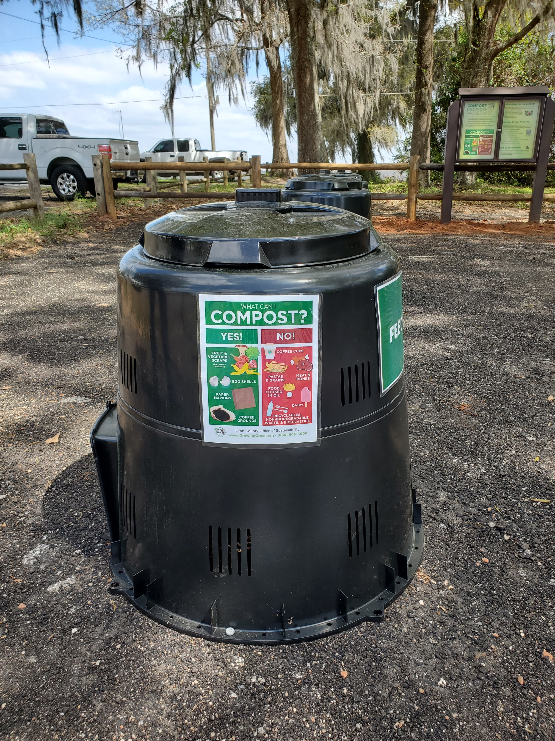
COMPOSTING FACILITIES
EXEMPTIONS
Composting on the farm:
Applies to normal farming operations.
For use on and off the farm.
Exemptions - 62-709.305, F.A.C.
Agricultural Best Management Practices - Florida Department of Agriculture and Consumer Services (fdacs.gov).
Community Composting – 15 known operations:
Composting < 100 cubic yards of organic solid waste.
Material generated onsite or offsite.
Neighborhood, school or university and other institutions.
Composting for Community Map – ILSR.org.
Backyard Composting:
Composting of grass clippings, leaves and food waste.
Waste is generated by the homeowner or tenant.
Notes:
Backyard Composting – Homeowner or tenant of a single or multi-residential unit

Slide 7
ORGANICS RECYCLING FACILITIES
REGISTRATIONS AND PERMITS
SOPF Registration:
Chapter 62-709, F.A.C.
Chapter 62-701, F.A.C. – general provisions.
Limited to one year – must renew annually.
Solid Waste Composting Facility Permit:
Chapter 62-701, F.A.C.
Chapter 62-709, F.A.C.
Permit required – five years.
Solid Waste Organic Recycling Pilot Project Permit:
Chapter 62-709, F.A.C.
Permit required – 18 months, with option to extend.

Slide 8
ORGANICS RECYCLING FACILITIES
REGISTRATIONS AND PERMITS - CONTINUED
Biosolids Processing/Composting Facility Permit:
Chapter 62-640, F.A.C.
Permit required – five years.
Biosolids with yard trash is regulated under Chapter 62-640, F.A.C.
Biosolids with organics other than yard trash is regulated under Chapters 62-640 and 62-709, F.A.C.
Air Program Anaerobic Digestion Permit:
Chapter 62-210, F.A.C.
Required for digestion of organic waste in the production of renewable natural gas (RNG).
Stormwater and Multi-Sector Generic (MSGP) Permits:
Chapters 62-620 and 62-621, F.A.C.
Each facility is evaluated on a case-by-case basis.
NPDES Stormwater Program | DEP and Stormwater FAQ’s.

Slide 9
ORGANICS RECYCLING FACILITIES
LOCAL REQUIREMENTS
Solid waste management is delegated to the counties and local municipalities by Chapter 403.706, Florida Statute.
Zoning/Land Use:
DEP does not evaluate local zoning or land use ordinances when determining whether to issue or deny a permit.
Must comply with local zoning and land use requirements.
Local Restrictions:
Local solid waste permits, if applicable.
Franchise agreements with waste haulers.
Flow control ordinances.
Local restrictions on processing certain feedstocks (e.g., manure, food waste, etc.).
Local restrictions for proximity to public utilities.

Slide 10
ORGANICS RECYCLING FACILITIES
REGULATORY CHALLENGES AT COMPOSTING FACILITIES
Fires at yard trash processing facilities.
Odor issues.
Stormwater violations.
Truck traffic.
Dust.
Volume thresholds/pile limits and mis-management of material.
Timely processing of unprocessed material and removal of finished material.
Poor recordkeeping.
Water body impacts.
Removal of incidental/unauthorized wastes.
Land use/zoning violations.

Slide 11
CHAPTER 62-709, F.A.C RULEMAKING
CRITERIA FOR ORGANICS PROCESSING AND RECYCLING FACILITIES
DEP Rulemaking for Chapter 62-709, F.A.C.
Last rule update in 2010.
Summary of proposed changes:
New definitions.
Restructure of registered and permitted composting facilities.
Operations plan requirement for registered facilities.
Additional criteria for fire protection controls.
Yard trash pile dimensions.
Revised metal concentration limits for finished compost.
Addition of new organic feedstocks (registration and/or permit):
Sargassum seaweed.
Liquid food waste.
Compostable products.
Domesticated pet waste.

Slide 12
CHAPTER 62-709, F.A.C RULEMAKING
DEFINITION UPDATES - PROPOSED
New Definitions:
Feedstock.
Community composting.
Mechanical compaction.
Sargassum seaweed.
Domesticated pet waste.
Compostable products – Biodegradable Products Institute (BPI) and American Society for Testing and Materials (ASTM) specifications.
Food waste (discards):
Pre- and post-consumer food waste.
Opened to residential collection.
Will replace current definitions of animal byproducts, pre-consumer vegetative waste and (post-consumer) vegetative waste.

Slide 13
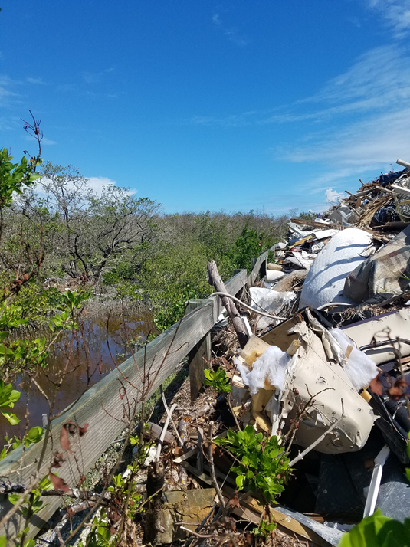
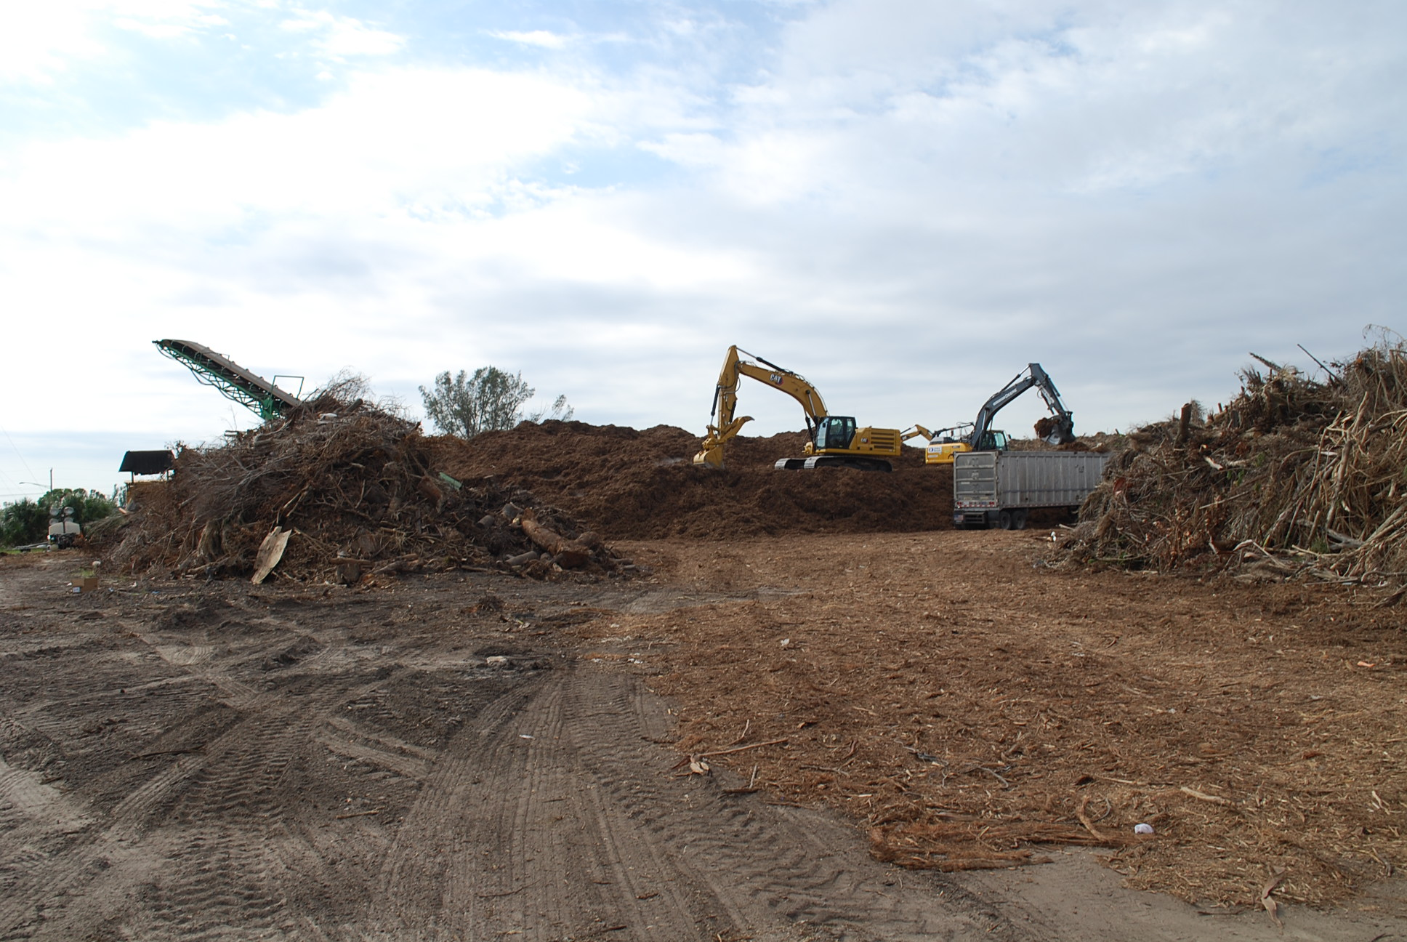
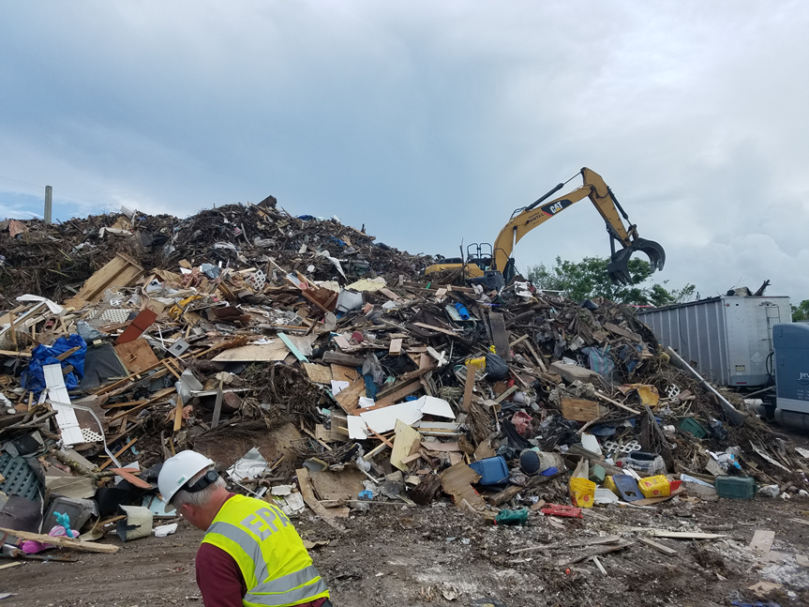
DISASTER DEBRIS MANAGEMENT
ORGANICS UPDATE
A Disaster Debris Management Site (DDMS) is a temporarily authorized solid waste processing facility subject to an Emergency Final Order.
DDMS’s Provide unique management challenges.
Pre-authorization process:
Annual process.
Request using DEP Business Portal or through DEP district/delegated county office.
Authorized to county governments.
Distribution and number of sites:
697 sites pre-authorized for 2023.
Sites pre-authorized statewide.

Slide 14
THE FLORIDA DEPARTMENT OF ENVIRONMENTAL PROTECTION
THANK YOU
Lauren O’Connor
Permitting and Compliance Assistance Program
Division of Waste Management
Florida Department of Environmental Protection
Contact Information:
850-245-8756
Lauren.OConnor@FloridaDEP.gov

Slide 15
THE FLORIDA DEPARTMENT OF ENVIRONMENTAL PROTECTION

